Slide 1

2D Oscillators for Oscillatory Neural Network to solve n-city Travelling Salesman Problem
EE746: Neuromorphic Engineering Project
Presented By:
Anugole Sai Gaurav and Vishwas Bharti
Third Year Undergraduate, EE Dept.
Mentor: Shashwat Shukla

Slide 2
Overview of the Project
Solving n-city TSP using Oscillators based Neural networks
Hopfield Tank representation of n ² neural units [1]
2-D Oscillator motion dynamics
n-Oscillator mapping with 1-D Motion Dynamics[2]
[1] Gregory S. Duane, A ‘Cellular Neuronal’ Approach to Optimization Problems
[2] Langde et al, Oscillator Network based Efficient Cost function for TSP ).

Slide 3
Mechanism of ONN
Mapping to an Energy Cost Function
Initialisation of phases through complex numbers
Stochastic Gradient Descent
Optimal tour order as output
Phase update till minima is reached
Simulated Annealing
zero-mean Gaussian noise, Ө(σ) with decaying σ, where σ is reduced by annealing rate α at each iteration.

Slide 4
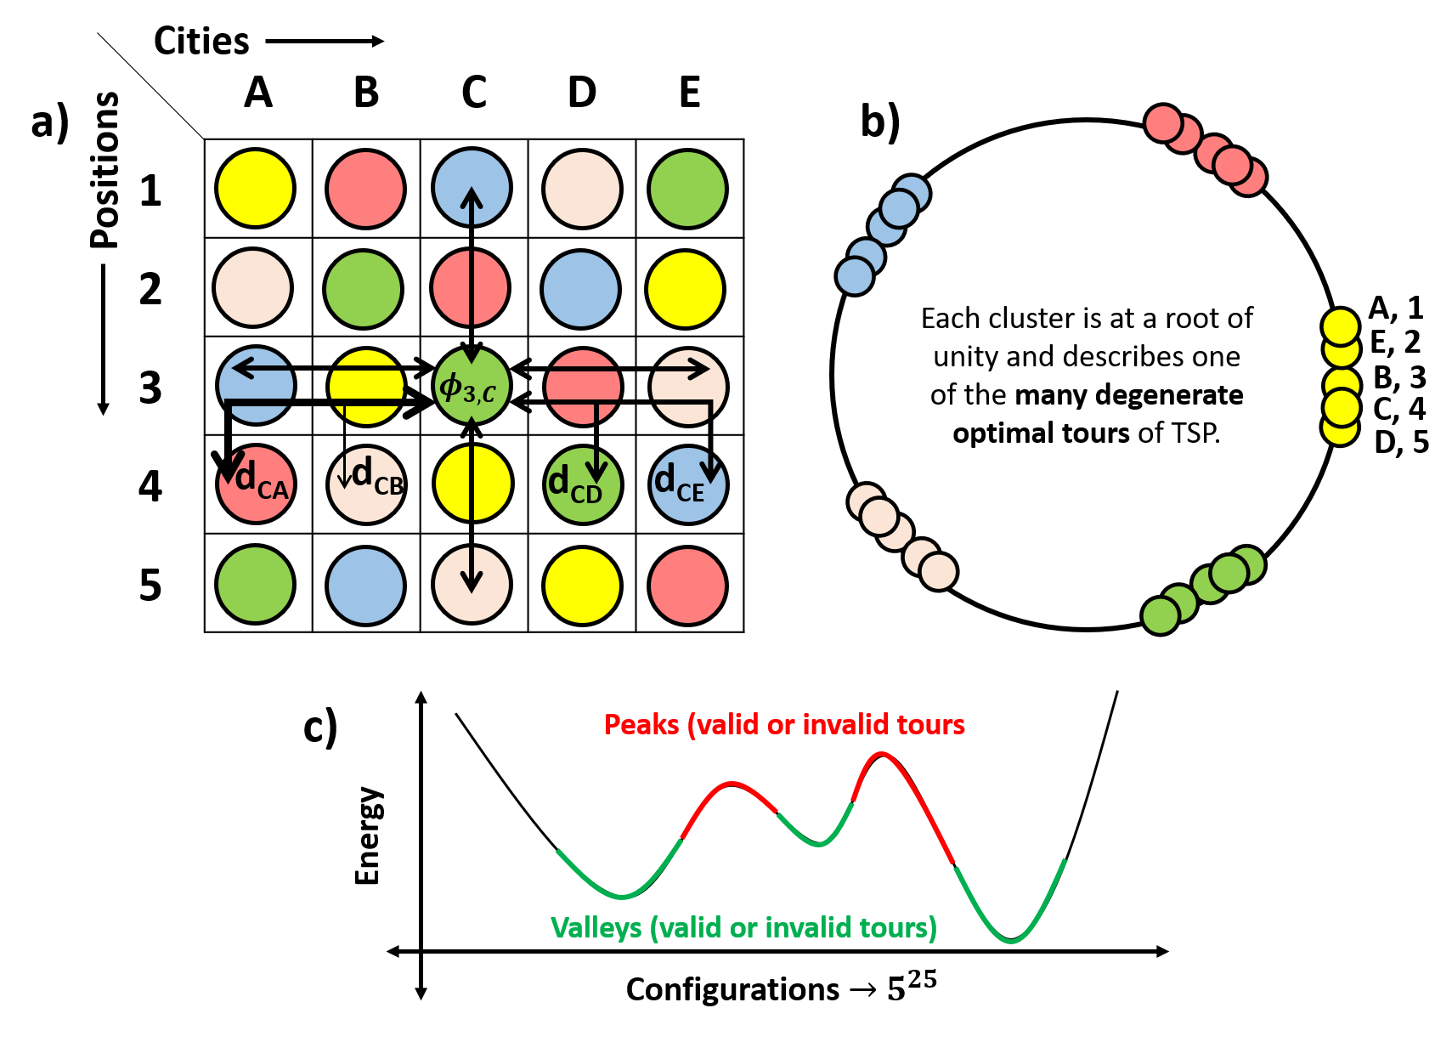
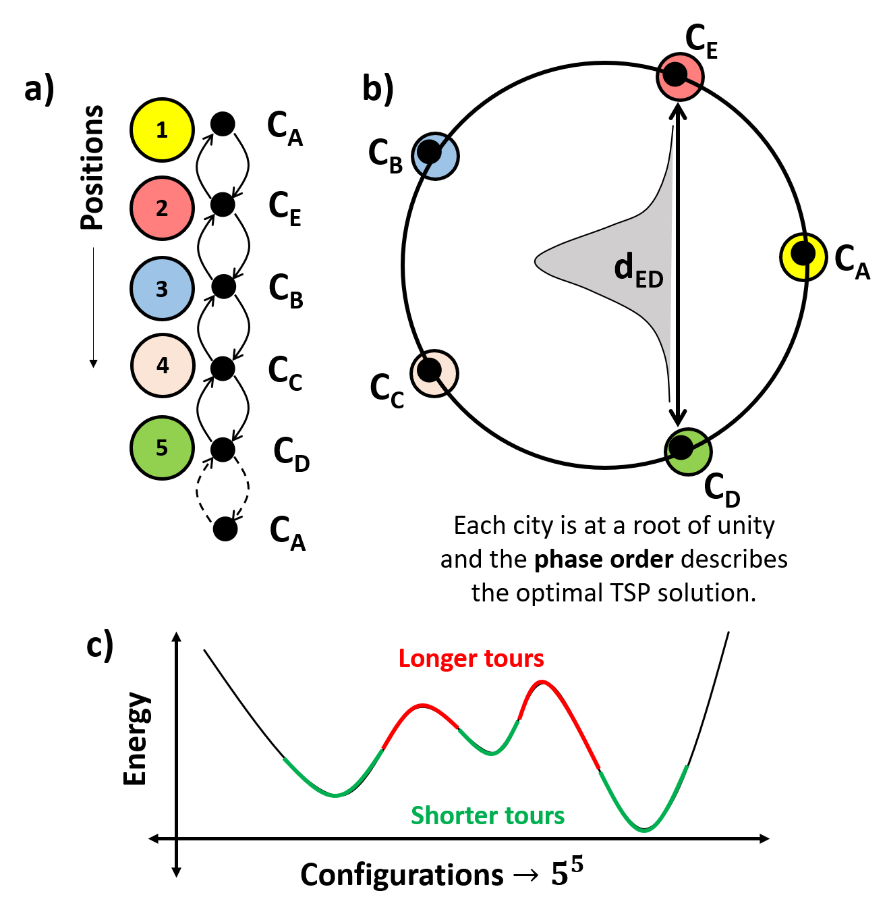
Previous Techniques of Oscillator mappings
n² Oscillator mapping
n Oscillator mapping
Cost function = Magnitude constraint + Unity root phase constraint +
Syntactic constraint + Distance minimimization constraint

Slide 5
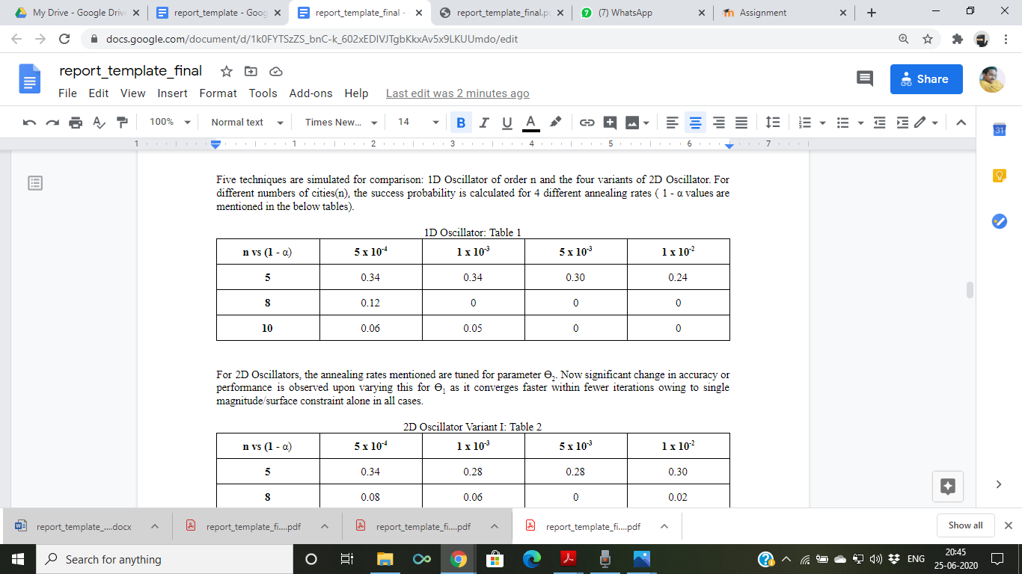
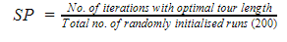
Simulation results for n-Oscillator mapping
For different numbers of cities(n), the success probability is calculated for 4 different annealing rates ( 1 - α values are mentioned in the below tables).

Slide 6
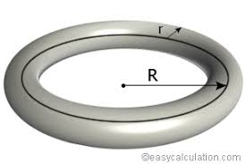
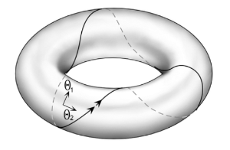
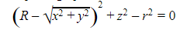
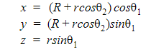
2D Oscillator: Variant I

Slide 7
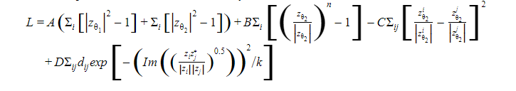
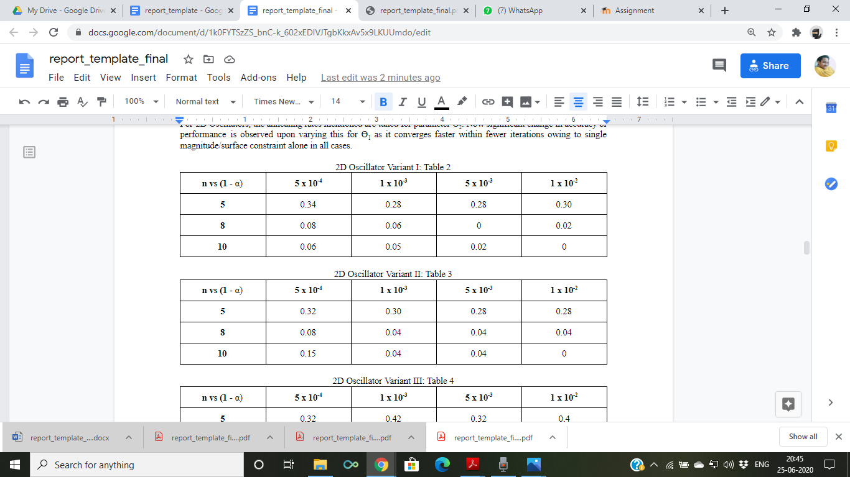
Cost function and results

Slide 8
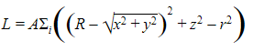
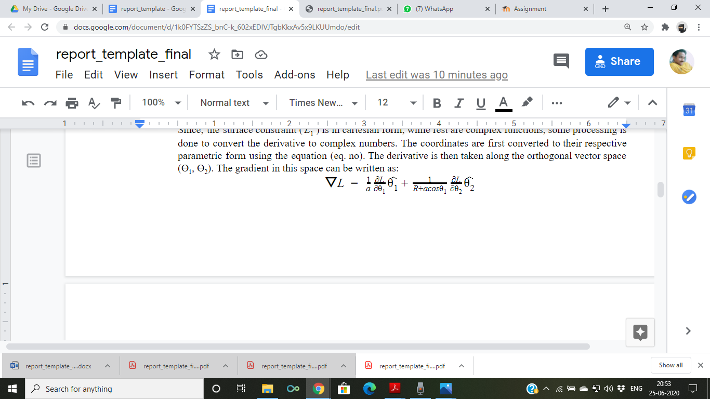
2D Oscillator: Variant II
Magnitude constraint replaced by surface constraint
Gradient calculated for 2 vectors
Gradient converted to complex number by chain rule

Slide 9
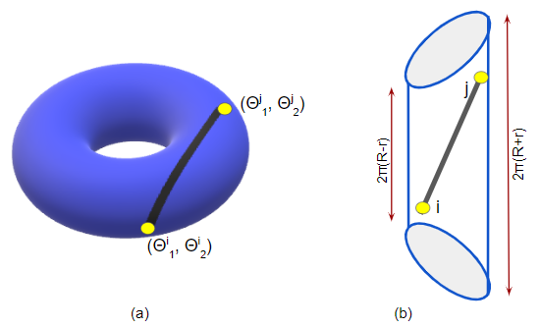

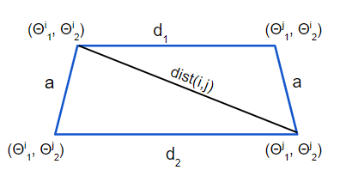
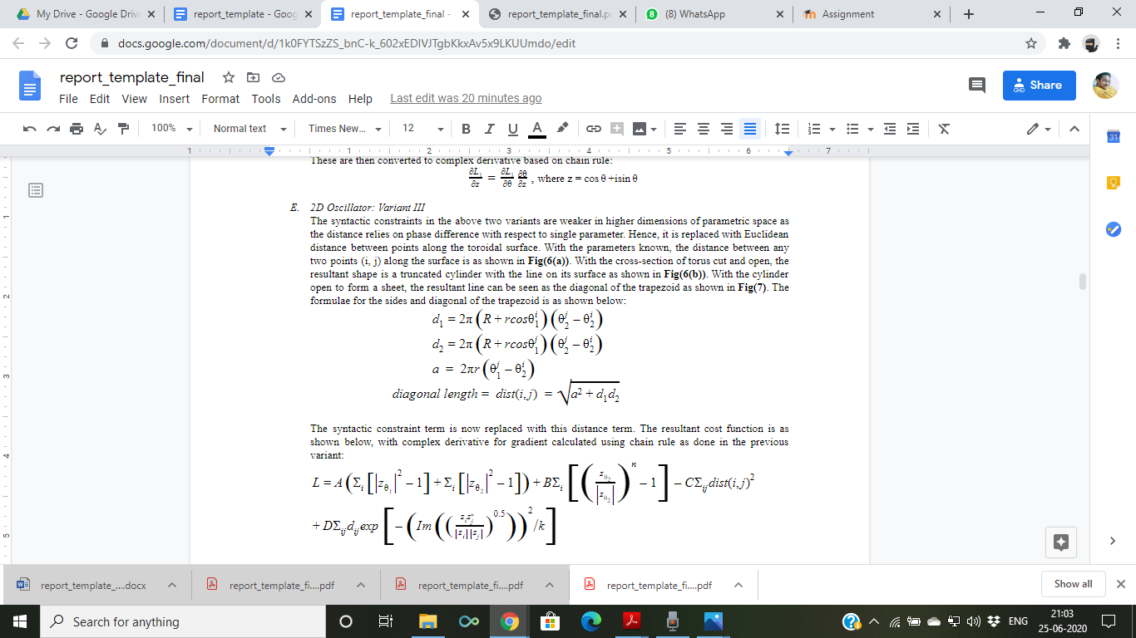
2D Oscillator: Variant III
Syntactic constraint modified with distance along toroidal surface between the points
New Syntactic constraint: C∑_{ij} dist(i,j)²

Slide 10
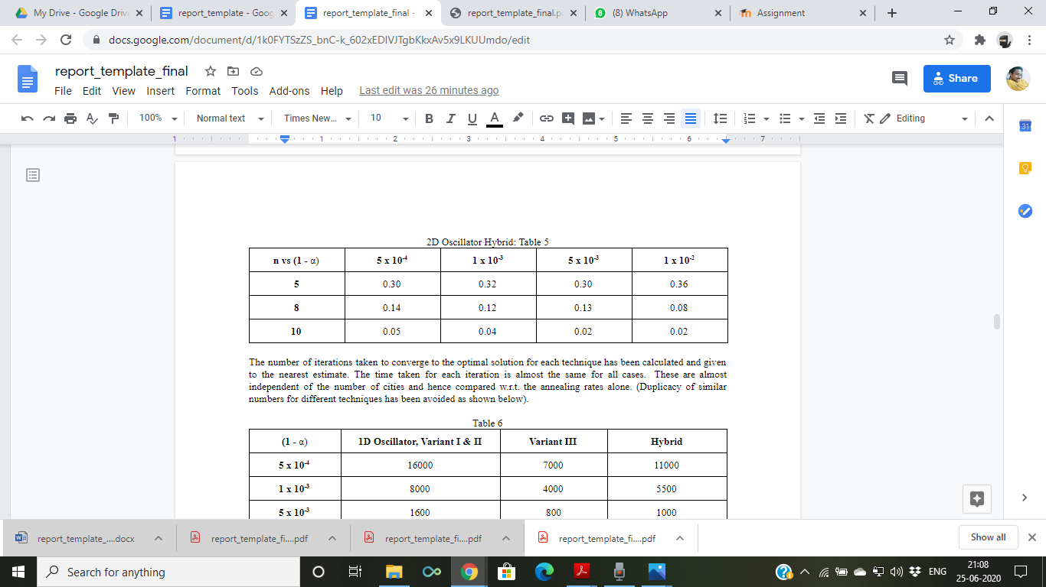
2D Oscillator: Hybrid (Variant II & III)
This is a hybrid of variant II and III with distance and syntactic constraint from the original replaced with the newly derived equation set.

Slide 11
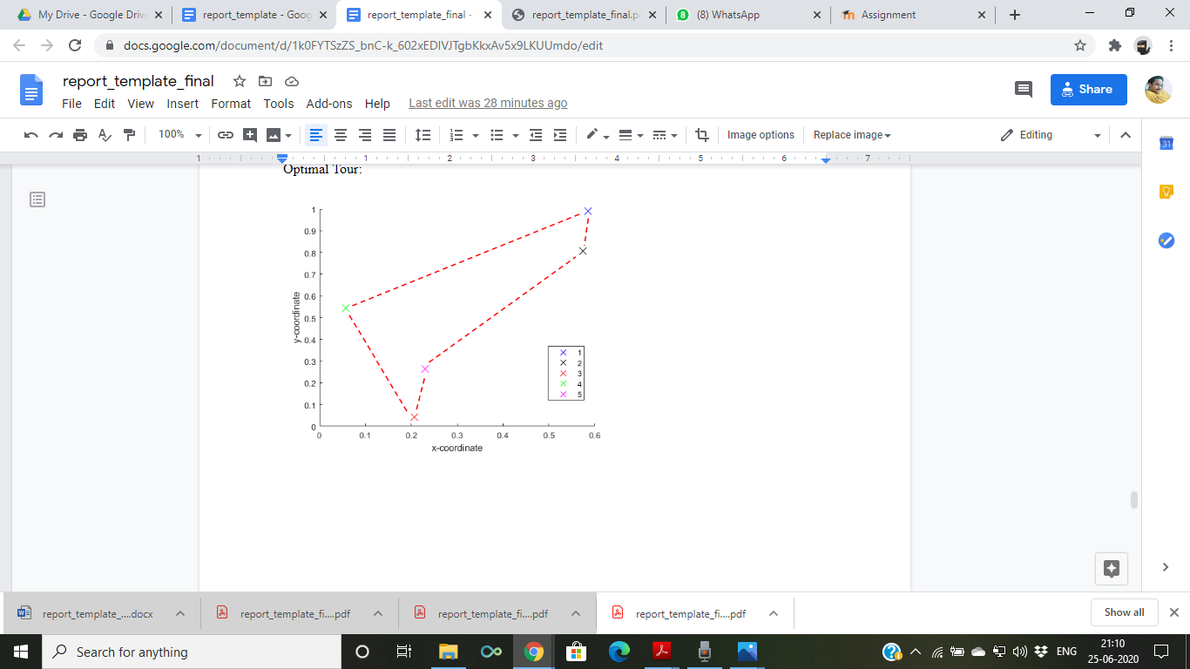
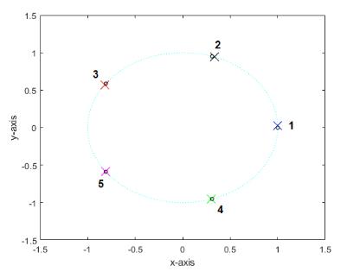
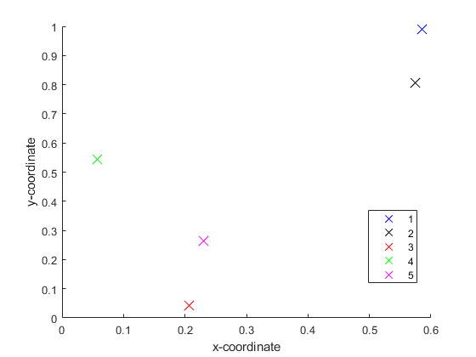
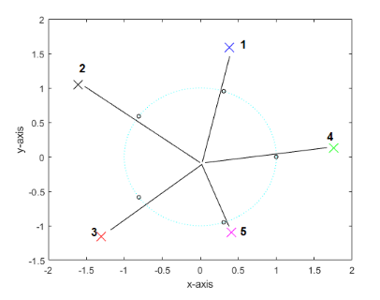
Results
Optimal Tour order
Magnitude Constraint Based Techniques
Surface Constraint based Techniques

Slide 12
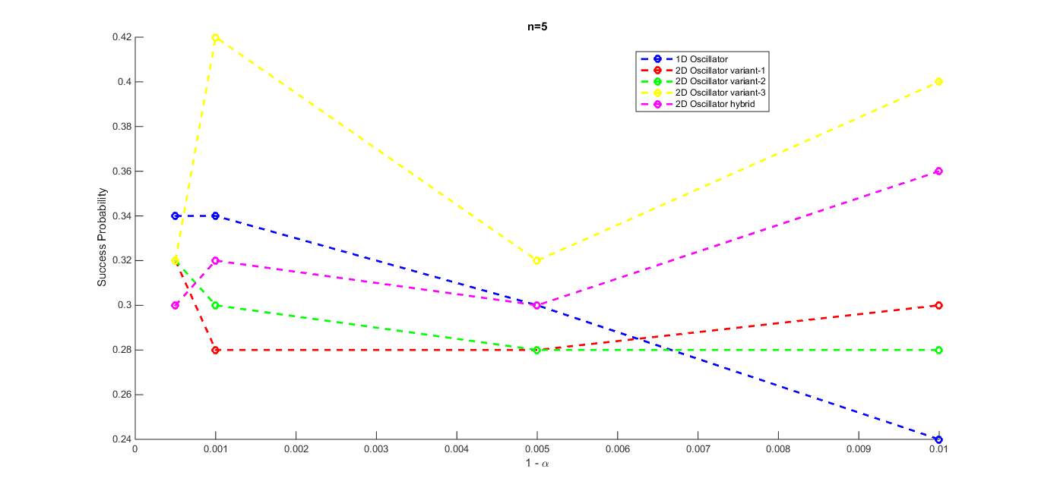

Slide 13
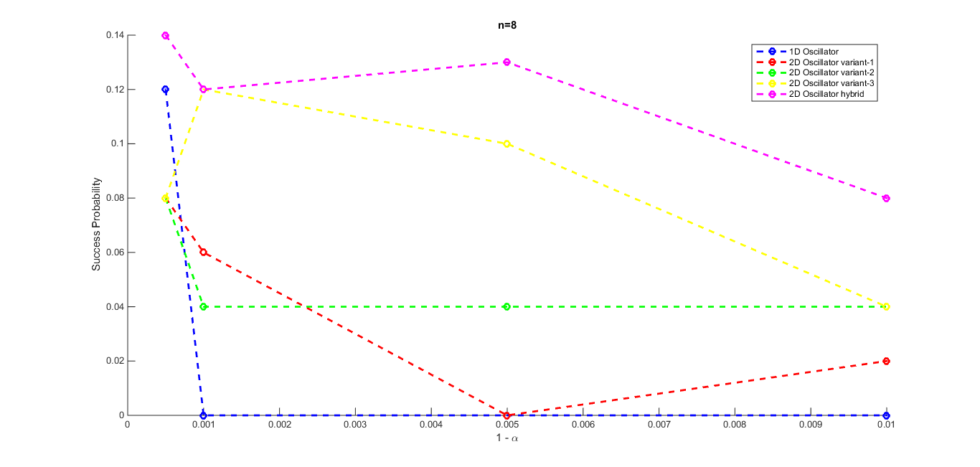

Slide 14
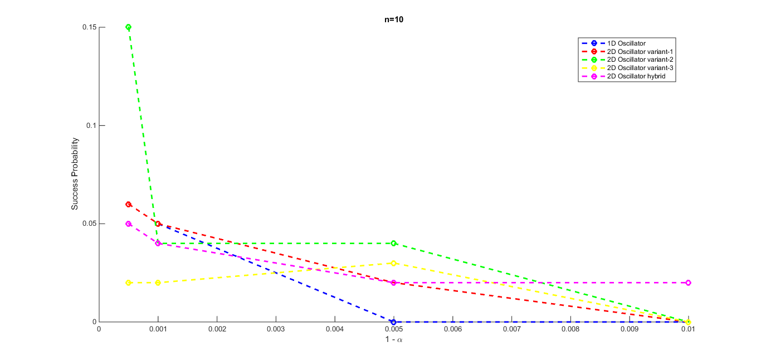

Slide 15
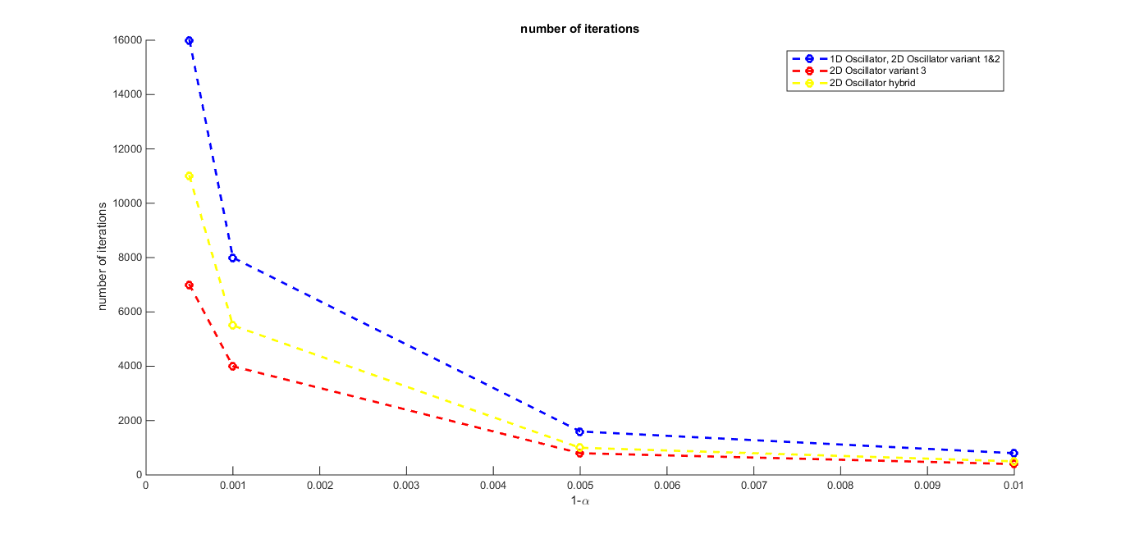
Computation Time Performance

Slide 16
Conclusion
The success probability only showed marginal improvement with the new dynamics
The accuracy decreases with the number of cities and slower annealing rate tend to give more optimal tour solutions most of the time
Maintaining the same accuracy, significant improvement in performance of the system is seen in this 2-D Oscillators dynamics
Hence, this new technique resembles 1D n-Oscillator mapping in terms of lesser number of oscillator units, reduced hardware area footprint, reduced search space and improved accuracy of optimal tours compared to n² mapping.
The convergence time is additionally reduced and thereby lower energy consumption in the device is also expected.
With usage of an oscillator based neural network in the Neuromorphic hardware space modelling real neurons, such techniques incorporated in compact devices can prove to be very much efficient in solving various optimization problems.

Slide 17
THANK YOU

